Slide 1

Learning Objective
I will use BIMDAS to calculate an expression.
Enter quietly, please be ready with the following on your desk:
Whiteboard
Whiteboard marker
Exercise Book
Pencil, pen, ruler and red pen
Diary
Calculator
Device – charged or borrowed from Library before maths

Slide 2
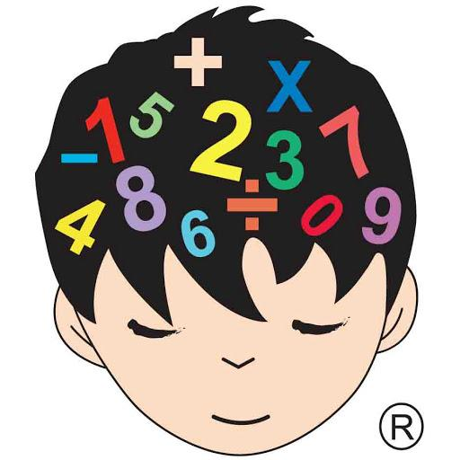
Daily Review
CFU
What does the commutative law state?
Commutative law – the order in which I add or multiply any two numbers does not change the answer
5 x 7 = 35
7 x 5 = 35
7 + 8 = 15
8 + 7 = 15

Slide 3
Daily Review
CFU
What does the associative law state?
Associative law – the order in which 3 or more numbers are added or multiplied, does not change the results
2 x 3 x 5 = 30
3 x 5 x 2 =30
6 + 7 + 8 = 21
7 + 6 + 8 = 21

Slide 4
Question
There may be more than one!!
Which of the following are examples of the associative law?
A: 3 + 14 = 4 + 13
B: 10 + 6 = 8 + 8
C: 7 x 6 = 6 x 7
D: 4 + 2 + 10 = 10 + 4 + 2
E: 8 x 3 = 3 x 8
F: 2 + 10 = 10 + 2

Slide 5

Daily Review
CFU
What does the distributive law involve?
Distributive law – we split large numbers into 1s, 10s and 100s
7 x 16
7 is a small number so we leave it as it is
16 is a large number so we split it into 10 + 6

Slide 6
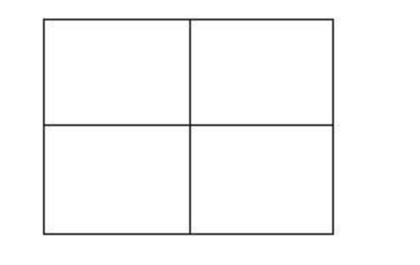
Daily Review
CFU 1
What is step 1 in using an array?
Calculate 39 x 56 using an array:
CFU 2
Step 1: split the numbers into 1s and 10s
39 x 56 = (30 + 9 ) x (50 + 6 )
What is step 2 in using an array?
CFU 3
What is step 3 in using an array?
Step 2: enter the numbers on the sides of the array
30 9
CFU 4
What is step 4 in using an array?
50
6
1500
450
180
54
1500
450
180
54
+
Step 3: multiply each horizontal by each vertical and enter in the array
2184
Step 4: add up each number inside the array

Slide 7
Daily Review
CFU 1
What is step 1 in using an array?
Calculate 42 x 72 using an array:
Whiteboards
CFU 2
Step 1: split the numbers into 1s and 10s
42 x 72 = (40 + 2 ) x (70 + 2 )
What is step 2 in using an array?
CFU 3
What is step 3 in using an array?
CFU 4
What is step 4 in using an array?

Slide 8
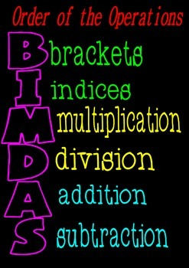
Learning Objective
CFU
What will we learn today?
CFU
I will use BIMDAS to calculate an expression.
How will you know that you are successful?
Success Criteria
At the end of the lesson, I will be able to:
Correctly calculate an expression using BIMDAS

Slide 9












Activate Prior Knowledge
Why do we have road rules in Australia?
What would happen if we could pick which side of the road we wanted to drive on?

Slide 10

CHAOS!

Slide 11

Relevance
Mathematicians don’t like chaos.
So they decided to come up with something called the ‘Order of Operations’.
You might have heard of it by a different name:
BIMDAS

Slide 12

Concept Development
CFU
BIMDAS
What does BIMDAS stand for?
What does it stand for?
Blue Iguanas Must Dance All Saturday.
…only kidding.
Brackets, Indices / Multiplication & Division / Addition & Subtraction
This is the order that we perform calculations in.
CFU
What do we use BIMDAS for?
1. Brackets first.
2. Indices next.
3. Multiplication and Division in order from left to right.
4. Addition and Subtraction in order from left to right.
CFU
What comes after brackets in BIMDAS?

Slide 13
Skill Development
CFU
UNDERLINE, DO and DROP.
What does BIMDAS stand for?
BIMDAS
1. Brackets first.
2. Indices next.
3. Multiplication and Division in order from left to right.
4. Addition and Subtraction in order from left to right.
CFU
What order do you do multiplication and division in?
CFU
What is the strategy for setting out your work?
Whiteboards
Is there any:
1. Brackets?
5 x 3 - 2
10 ÷ 2 + 6
8 + 3 x 2
20 – 16 ÷ 8
No
=
15
- 2
2. Indices?
No
=
13
3. Multiplication or Division?
Yes! Underline, do & drop!
4. Addition or Subtraction?
Yes! Underline, do & drop!

Slide 14
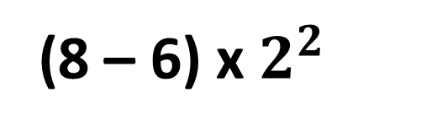
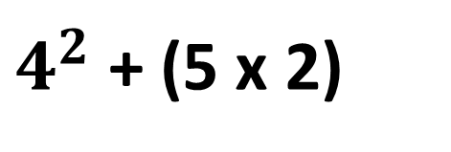
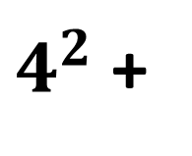
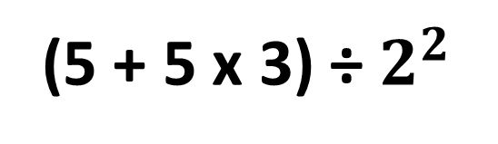
Skill Development
CFU
UNDERLINE, DO and DROP.
What does BIMDAS stand for?
BIMDAS
1. Brackets first.
2. Indices next.
3. Multiplication and Division in order from left to right.
4. Addition and Subtraction in order from left to right.
CFU
What order do you do addition and subtraction in?
CFU
What is the strategy for setting out your work?
Whiteboards
$4^{2}$ + (5 x 2)
Is there any:
1. Brackets?
(8 – 6) x $2^{2}$
(5 + 5 x 3) ÷ $2^{2}$
=
$4^{2}$ +
10
Yes! Underline, do & drop!
2. Indices?
Yes! Underline, do & drop!
=
16
+ 10
No
3. Multiplication or Division?
=
26
4. Addition or Subtraction?
Yes! Underline, do & drop!

Slide 15
Guided Practice
CFU
UNDERLINE, DO and DROP.
What does BIMDAS stand for?
BIMDAS
1. Brackets first.
2. Indices next.
3. Multiplication and Division in order from left to right.
4. Addition and Subtraction in order from left to right.
CFU
What is the strategy for setting out your work?
Whiteboards
$4^{2}$ + (5 x 2)
14 + 5 x 2
8 – 10 ÷ 2
=
$4^{2}$ +
10
=
16
+ 10
=
26

Slide 16
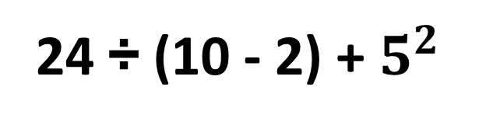
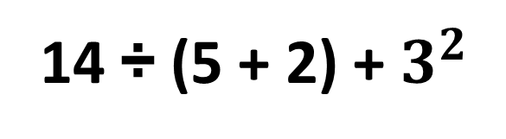
Guided Practice
CFU
UNDERLINE, DO and DROP.
What does BIMDAS stand for?
BIMDAS
1. Brackets first.
2. Indices next.
3. Multiplication and Division in order from left to right.
4. Addition and Subtraction in order from left to right.
CFU
What is the strategy for setting out your work?
Whiteboards
$4^{2}$ + (5 x 2)
24 ÷ (10 - 2) + $5^{2}$
14 ÷ (5 + 2) + $3^{2}$
=
$4^{2}$ +
10
=
16
+ 10
=
26

Slide 17
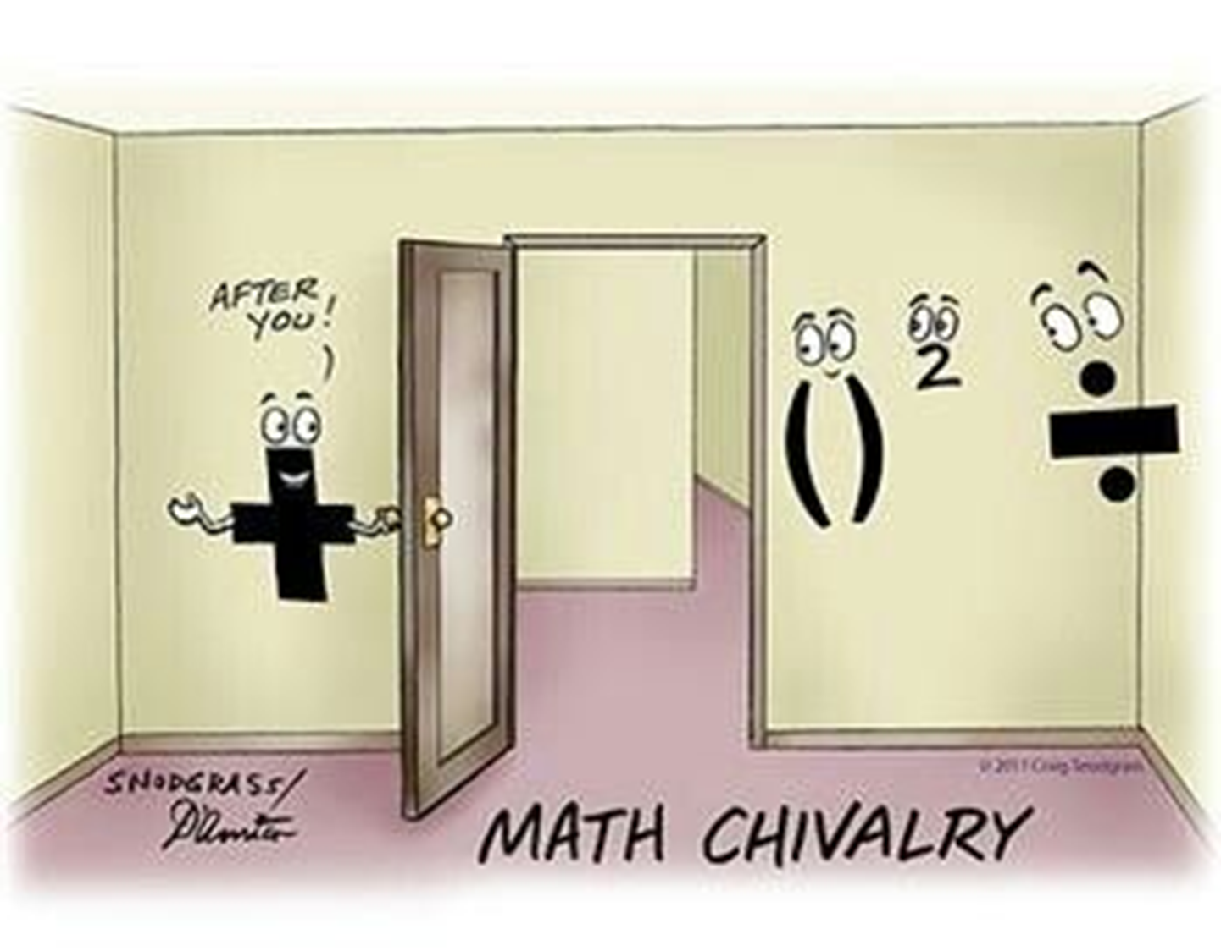
Skill Closure
What have we learnt today?
Lesson Objectives:
I will use BIMDAS to calculate an expression.
What does BIMDAS stand for?
Brackets
Indices
Multiplication
Division
Addition
Subtraction

Slide 18
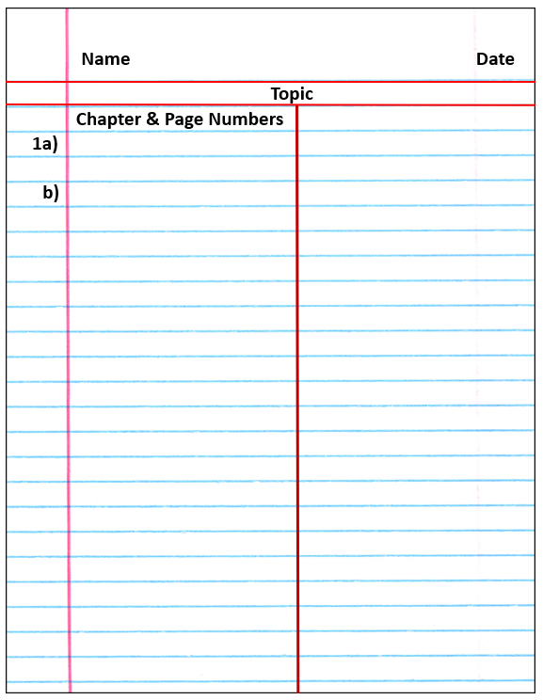

Independent Practice
Mathematics Page Layout
Open your textbooks to:
Chapter 1.5
Questions: 1 - 3(Every 2nd question), 4 – 8

